Slide 1
Relational data

Slide 2
Four main types of operations with two tables
Binding, which simply stacks tables on top of or beside each other
Mutating joins, which add new variables to one data frame from matching observations in another.
Filtering joins, which filter observations from one data frame based on whether or not they match an observation in the other table.
Set operations, which treat observations as if they were set elements.

Slide 3
Row binds and column binds
Row binding (e.g. dplyr::bind_rows() or base::rbind())
Different approaches for row binding have different combinations of flexibility vs rigidity
Usually works when it should and usually doesn’t when it shouldn’t
Column binding (e.g. dplyr::bind_cols() or base::cbind())
Your job to ensure the rows are aligned – easy to make mistakes
Dangerous – avoid whenever possible
Use join functions instead

Slide 4
Keys
A variable (or set of variables) that uniquely identifies an observation
A primary key uniquely identifies an observation in its own table [can be a set of variables]. For example, planes$tailnum is a primary key because it uniquely identifies each plane in the planes table.
A foreign key uniquely identifies an observation in another table [can be a set of variables]. For example, the flights$tailnum is a foreign key because it appears in the flights table where it matches each flight to a unique plane.

Slide 5
Exercise
We just added the full airline names to our flights2 dataset. Now try to instead add information about each plane from the dataset named planes

Slide 6
Understanding joins

Slide 7
Understanding joins
Each potential match

Slide 8
Understanding joins
Each potential match
Number of actual matches
Inner join: Unmatched rows are not included in the output

Slide 9
Understanding joins
Each potential match
Number of actual matches
Inner join: Unmatched rows are not included in the output
Could result in loss of observations – use with care

Slide 10
Outer joins
Keeps all observations in x
Keeps all observations in y
Keeps all observations in x and y

Slide 11
Outer joins
Left joins should be our default
Keeps all observations in x
Keeps all observations in y
Keeps all observations in x and y

Slide 12
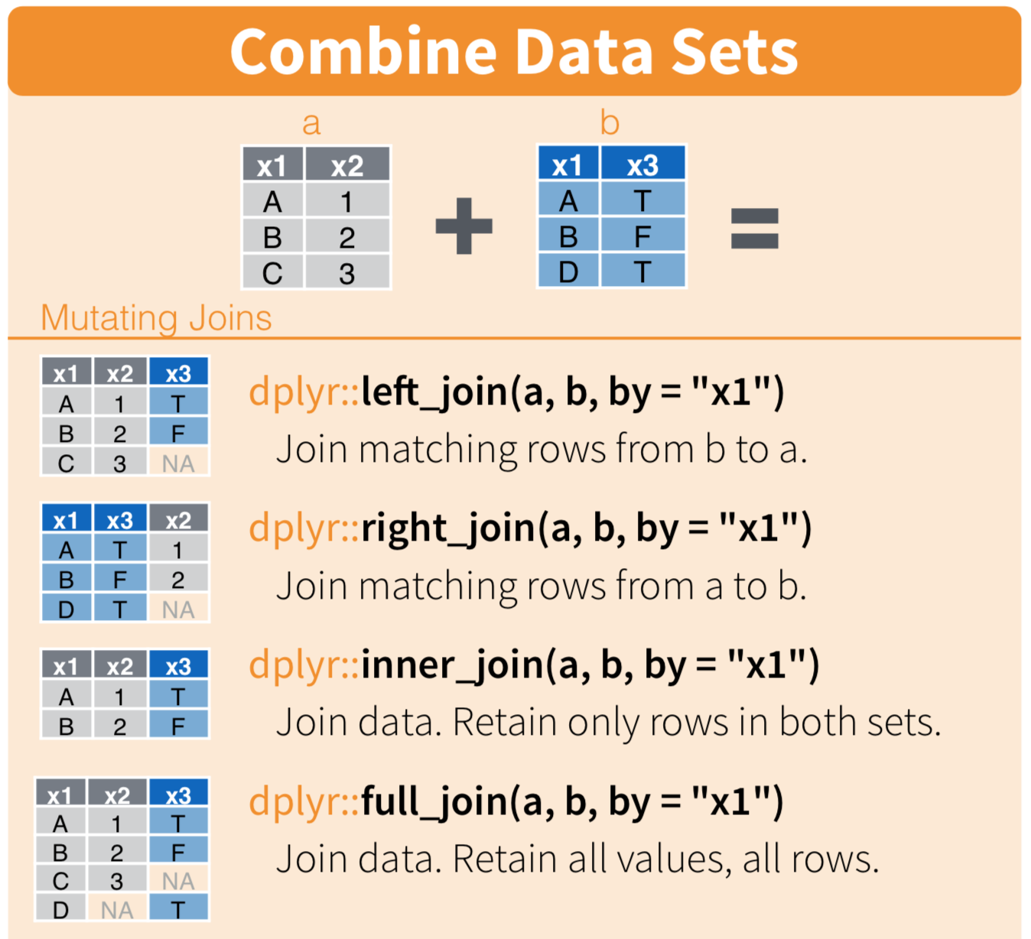

Slide 13
Relations
Typically one-to-many
Each flight has one plane, but each plane has many flights
Can also be many-to-many
Each airline flies to many airports; each airport hosts many airlines
Can also be one-to-one

Slide 14
Duplicate keys
One table has duplicate keys (typically a one-to-many relationship) e.g. “dest” in the flights tibble

Slide 15
Duplicate keys
Both tables have duplicate keys (typically an error)

Slide 16
Exercise
Add the location of the origin and destination (i.e. the lat and lon) to flights. You may want to use the suffix parameter to disambiguate variable names in your output
OPTIONAL QUESTION: Is there a relationship between the age of a plane and its delays? [You will have to work with the full flights data to access delay data]

Slide 17
Filtering
Filters the observations, does not add variables
semi_join(x, y) keeps all observations in x that have a match in y.
anti_join(x, y) drops all observations in x that have a match in y.

Slide 18
Semi-join
Anti-join

Slide 19
Exercises
Filter flights to only show flights with planes that have flown at least 100 flights (hint: you will need to first use summarize())
Combine fueleconomy::vehicles and fueleconomy::common to find only the records for the most common models

Slide 20
Join problems – how to troubleshoot
Start by identifying the variables that form the primary key in each table based on your understanding of the data
Check that none of the variables in the primary key are missing. If a value is missing then it can’t identify an observation!
Check that your foreign keys match primary keys in another table. The best way to do this is with an anti_join()

